Slide 1
Inventory Management System
Implementing Modern Java Technologies in an Inventory Management System
Presented by: Ravi Priy

Slide 2
Presentation Outline
Introduction
Technology Stacks
Spring Boot, Thymeleaf, Oracle DB, Apache Camel, JavaScript and Ajax, AOP, Spring Jdbc
Project Overview
Application Flowchart
Db Schema
Key Functionality
Live Demo
Q/A ?
Presented by: Ravi Priy

Slide 3

Introduction
Objective:
The primary goal of this project is to develop an inventory management system that allows users to add
and sell products while maintaining
real-time updates of inventory data and
exploring various Java technologies.
Technology Stack:
Backend: Spring Boot
Database: Oracle Database
Frontend: Thymeleaf, JavaScript, AJAX
Integration: Apache Camel

Slide 4

Spring Boot

Slide 5
What is Spring Boot?
Spring Boot is an extension of the Spring Framework aimed at simplifying the setup, configuration, and development of new Spring applications.
80% of Configurations are automatic.
It provides an easier and faster way to set up, configure, and run both simple and web-based applications.
Spring Framework
Embedded Server
Configuration
Spring Boot
Tomcat, jetty, etc

Slide 6
Advantages of Spring Boot?
It creates stand-alone Spring applications that can be started using java –jar.
Embed Tomcat, Jetty or Undertow directly ( no need to deploy WAR files )
Automatically configure Spring and 3rd party libraries whenever possible
Provide production-ready features : metrics, health checks and externalized configuration
Absolutely no code generation and no requirement for XML configuration.

Slide 7
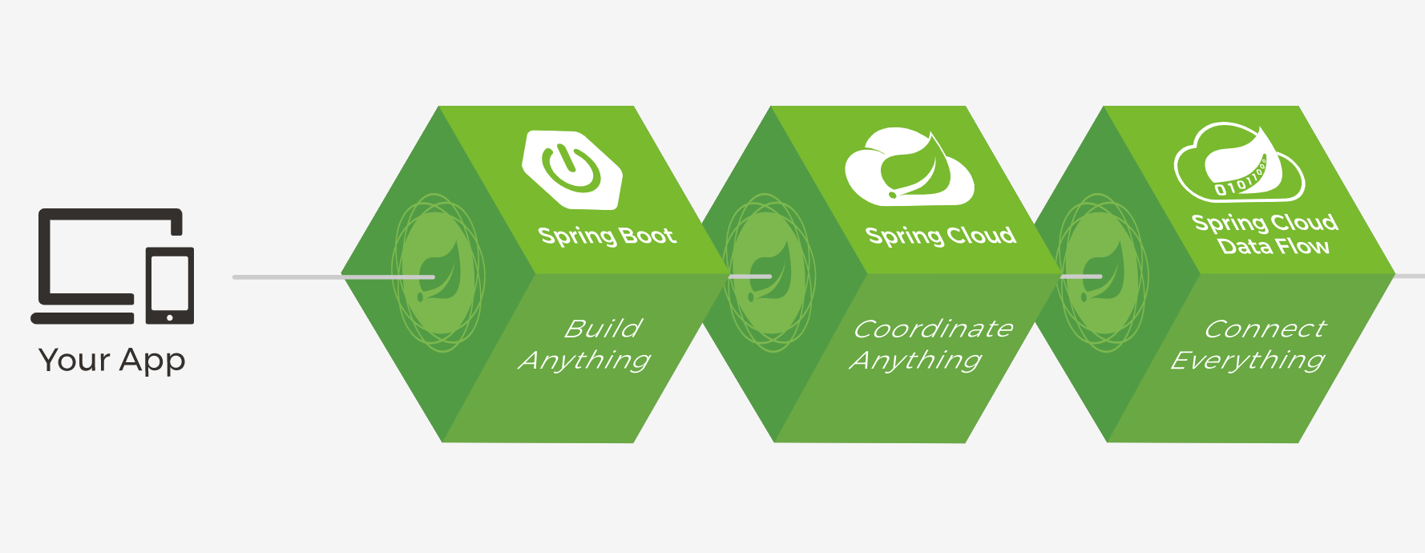

Slide 8
Spring Boot
Framework of Frameworks
A powerful, flexible framework for building Java-based applications.
Provides easy configuration and dependency management.
Integration of Multiple Frameworks
Integration with Modern Technology
Convention over Configuration
Auto-Configuration
Ease of Use
Spring Initializr
Starter Dependencies
Extensive Ecosystem and Community Support
Spring-context (core features such as di, aop, tm, etc)
spring-webmvc : For building web applications with RESTful APIs.
Spring Data : JPA, MongoDB, Cassandra etc
Spring-security : core, config, web features for authentication and authorization.
Spring Batch : spring-batch-core : Batch Processing
Spring Integration core : EIP and Messaging
Use in Project:
Framework for the backend application.
Simplifies setup and deployment.

Slide 9

Thymeleaf
A modern server-side Java template engine for web applications.
Allows natural templating, making HTML templates readable by browsers.
//Client Side Coding
<!DOCTYPE html>
<html xmlns:th="http://www.thymeleaf.org">
//html with thymeleaf namespace
<tbody>
<tr th:each="product : ${products}">
<td th:text="${product.id}"></td>
</tr>
</tbody>
</html>
//Server side Coding
import org.springframework.ui.Model;
@Controller
public class ProductController {
public String getAllProducts(Model model) { List<Product> products = productService.getAllProducts(); model.addAttribute("products", products);
return "products";
}
}
Use in Project:
Render dynamic web pages.
Bind data from the server to the HTML view.

Slide 10
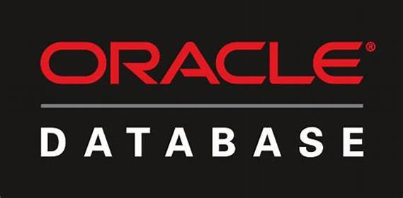
Oracle DB
A robust, enterprise-grade relational database management system.
Ensures data integrity and supports complex queries.
Use in Project:
Store and manage product inventory data.
Perform CRUD operations efficiently.

Slide 11
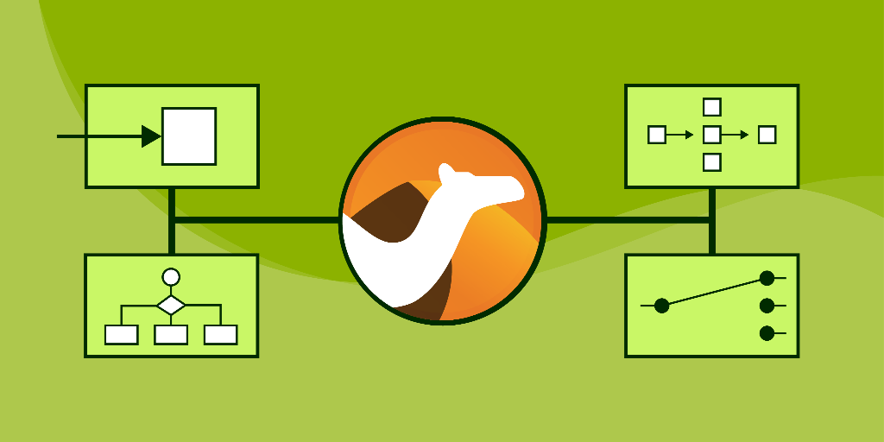

Apache Camel
An open-source integration framework.
Simplifies the integration of various systems using routing and mediation rules.
Why Apache Camel?
Simplifies Integration
Supports Many Protocols
HTTP, FTP, JMS, and many others
Easily Configurable

Slide 12
Apache Camel
An open-source integration framework.
Simplifies the integration of various systems using routing and mediation rules.
Why Apache Camel?
Simplifies Integration
use ready-made solution instead of writing complex code.
Supports Many Protocols
HTTP, FTP, JMS (java msg service),, and many others
Easily Configurable
Use in Project:
Handle routing logic for inventory updates.
Ensure seamless monitoring on Product (selling)

Slide 13
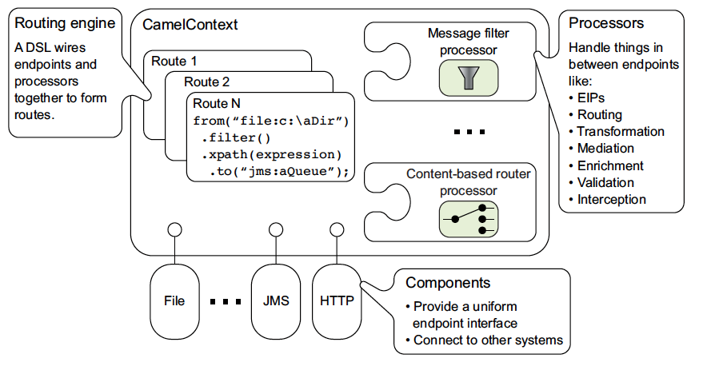
Apache Camel Architecture
Routes : a route
Components : file, reading emails, accessing db, ….
Processors : Translator
File :: Apache Camel
DSL(Domain Specific Language)
Java, XML, Spring, Yaml, REST, Annotation

Slide 14


JavaScript and Ajax
JavaScript: A versatile, client-side scripting language.
AJAX: Asynchronous JavaScript And XML, allows updating web pages without reloading. It is used to communicate with the server without refreshing the web page and thus increasing the user experience and better performance.
Use in Project:
Enhance user interaction.
Submit forms and update product data without refreshing the page.

Slide 15
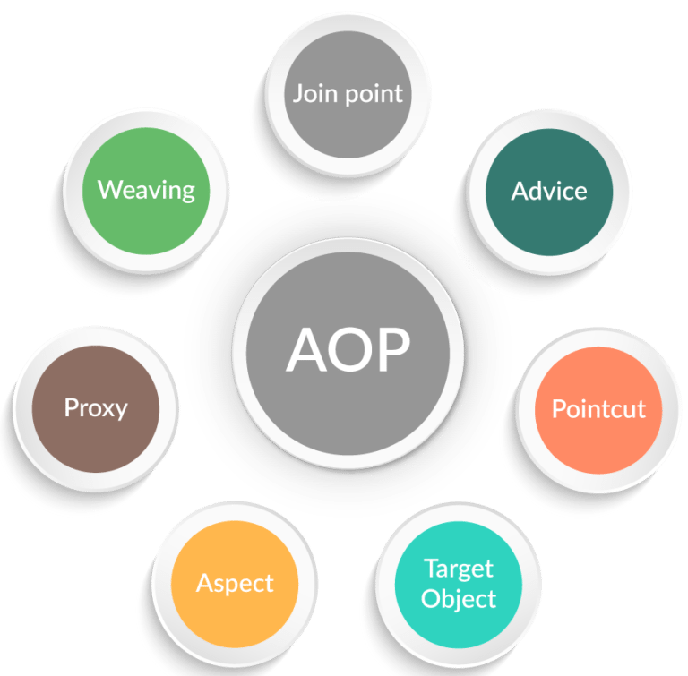
Aspect-Oriented Programming (AOP)
It is a programming approach that helps separate different parts of a program to make it easier to manage and understand.
In many application, there are common tasks like logging, security checks, or transaction management that are needed in multiple places. These tasks are called cross-cutting concerns because they "cut across" many parts of the application.

Slide 16
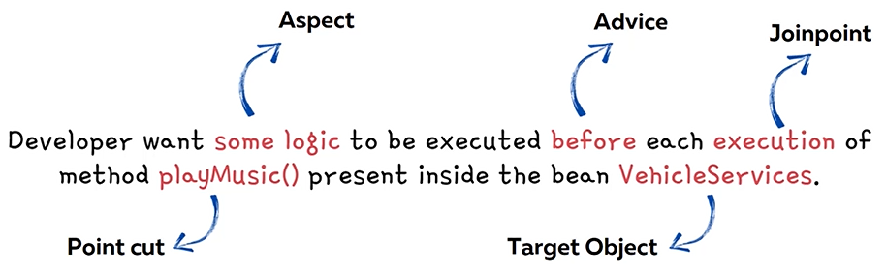
Demo

Slide 17
Aspect-Oriented Programming (AOP)
What : Aspect
What code or logic we want spring to execute when we call a specific method. This is called as Aspect.
When : Advice
When spring need to execute the given Aspect. For an example is it before or after the method call. This is called Advice.
Which : Pointcut
Which method inside App that framework need to intercept and execute the given Aspect. This is called as a Pointcut.

Slide 18
Spring JDBC
A Spring module that simplifies JDBC operations.
Provides a template for managing database connections and queries.
JDBC : Java Database Connectivity Normal Java Jdbc
Normal Java JDBC Code / Steps
Load Oracle JDBC Driver: Class.forName("oracle.jdbc.driver.OracleDriver");
Establish Connection: DriverManager.getConnection(jdbcUrl, username, password);
Create and Execute SQL Query:
Process ResultSet:
Close Resources:
We need to write a lot of codes.
ConnectionOpen -> statement -> execute -> connectionClose
Exception Handling Problem: checked Exception : SQLException
Repeating all these codes from one to another database logic is a time consuming task.

Slide 19
Spring JDBC
1: Maven Dependencies: Include Spring Boot JDBC starter and Oracle JDBC driver.
org.springframework.boot
com.oracle.database.jdbc
2: Application Properties: Configure the database connection details.
spring.datasource.url=
spring.datasource.username=
spring.datasource.password=
spring.datasource.driver-class-name=
Demo
Google docs

Slide 20
Project Overview
A
Add Product
B
Sell Product
C
Product List
D
Total Inventory Cost
Features
E
Apache Camel Integration

Slide 21
Application Flowchart
Start
Enter Product Details
Start
Select Product & Quantity
Checks Product Quantity
No
Alert User
If Product Exists
No
Add New Product
Sufficient
Update Quantity
Yes
Save To Db
Quantity Becomes Zero ?
Add Product
Update Quantity
Sell Product
Update Quantity
No
Yes
Update Db
Remove Product
End
Update UI
Update UI
End

Slide 22
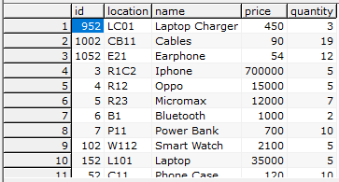
Database Schema
Table: Product table with fields for ID, name, quantity, price, and location.

Slide 23
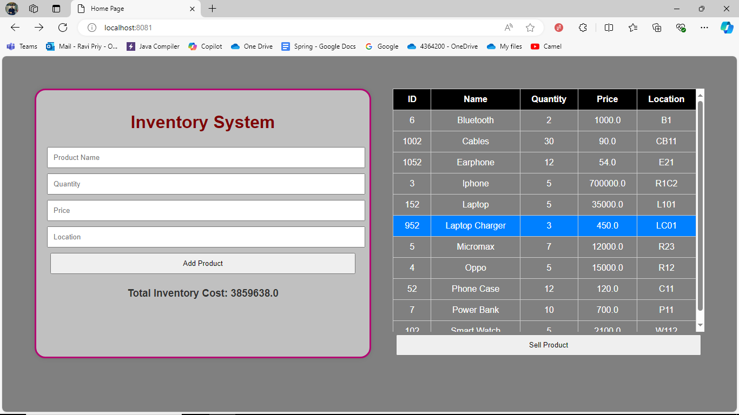
Important Key Functionalities
Add Product:
Form: Users input product details into a form and submit it.
Backend Handling: The backend saves the product details into the database.
Code Snippet:
@PostMapping("/addProduct")
@ResponseBody
public Map<String, Object> addProduct( params ) {
if (existingProductOpt.isPresent()) {
// update quantity
} else {
//new product added
}
return response;
}

Slide 24
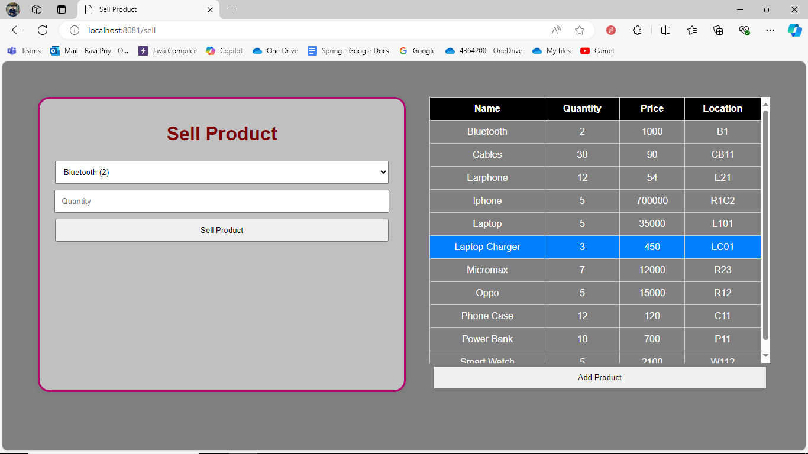
Important Key Functionalities
Sell Product:
Process: Users select a product and specify the quantity to sell. The system validates and updates the inventory.
Code Snippet:
@PostMapping("/sellProduct")
public ResponseEntity<String> sellProduct( params ) {
if (quantity > product.getQuantity()) {
// insufficient quantity
}
if (newQuantity == 0) {
// removed from database
} else {
// Product sold
}
}

Slide 25
Important Key Functionalities
Display Inventory:
Frontend: A table displays the product details dynamically.
Code Snippet(JavaScript for AJAX update)
function fetchProducts() {
$.get('/getProducts', function (data) {
$('#table-data tbody').empty();
$.each(data, function (index, product) {
$('#table-data tbody').append(
// table data
);
});
});
}

Slide 26
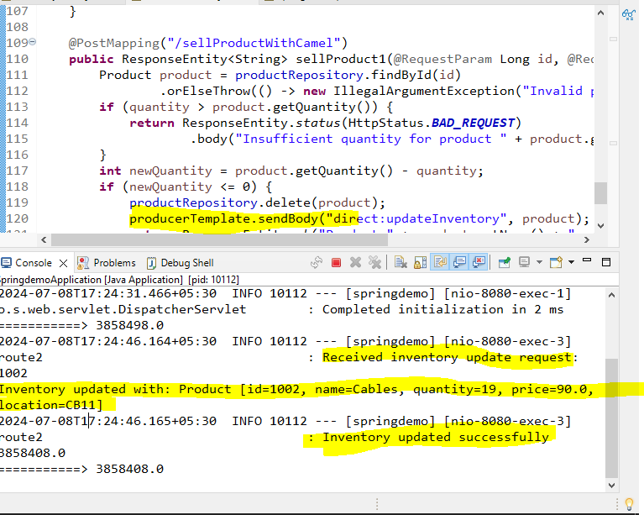
Important Key Functionalities
Apache Camel Integration
Purpose: Apache Camel is used to integrate with external systems for real-time inventory updates.
Route Example:
@Component
public class InventoryRoute extends RouteBuilder {
@Override
public void configure() throws Exception {
from("direct:updateInventory")
.to("http://inventory-api.com/update")
.log("Inventory updated successfully");
}
}

Slide 27
Live Demo
The working Inventory Management System.
Adding, selling, and updating product inventory.
The use of AJAX for seamless updates.

Slide 28
Conclusion
Summary:
Java technologies used.
Key benefits of the implemented system (Ajax and without Ajax)
Q&A:
?

Slide 29
Thank You

